Slide 1
AISA · AI PD STATIONS
Make something you’ll use next week
A hands-on hour with the AI tools you already have
PD Day · 19–20 October 2026
Brandon Baki, Head of AI & Innovation
Notes:
Welcome everyone and let people settle.

Slide 2
THE NEXT 60 MINUTES
Mostly doing, very little talking
5 min
5 min
40 min
7 min
3 min
Arrive and settle in
Welcome and updates
Stations
Share what you made
Exit ticket
Choose your own path through the six stations.
Notes:
Keep the intro short. Most of the hour is hands-on.

Slide 3

AN UPDATE
We’re saying goodbye to MagicSchool
BEFORE ACCESS ENDS
Tuesday 20 October
AISA is not renewing MagicSchool. Nearly everything we did there, we can now do with tools we already have, inside our Google accounts.
Open your MagicSchool history and save anything you want to keep: copy it into a Google Doc or download it to your Drive.
Notes:
Be clear and positive. MagicSchool is ending and access stops on Tuesday 20 October. If staff have rubrics, lesson plans or resources they made there and want to keep, they should save them to Drive today. Then pivot: the rest of the hour shows what we already have.

Slide 4
WHY THESE STATIONS?
Built from what you told us
THE GAP WE FOUND
103 of 140 of you use AI often or daily.
140
70
staff survey responses
Secondary personal goals
Your top asks: differentiation, polished decks, fast and engaging activities instead of worksheets.
261
~40
Learning Hub AI module answers
emails and chats asking for help
Notes:
The pain is not access: most staff already use AI personally, mostly ChatGPT. It is getting fast, classroom-ready output inside the tools the school already pays for. Differentiation and engagement were the two most common Secondary goal focuses (16 and 17 of 70 goals). 105 of 140 already use AI for lesson planning. Research backs the hands-on format: most non-users cite a lack of skills, not interest, and only about a third of US teachers offered AI PD found it helpful (RAND), so we practise on real tasks instead of watching demos.

Slide 5
ALL USING TOOLS IN YOUR AISA ACCOUNT
Six stations
1 · CLASSROOM GEMINI
2 · GEMINI & SLIDES
3 · CLASSROOM GEMINI
Differentiation & Scaffolding
Polished Lesson Decks, Fast
Engagement & Participation
“Slides take my whole evening.”
“I need every student thinking.”
“One text doesn’t fit every reader.”
4 · GOOGLE VIDS
5 · CANVAS + ACTIVITY HUB
6 · BUILT AT AISA
Turn Slides into a Video
Code Class Activities
Data Anonymizer
“Absent students miss the lesson.”
“I want a game, but I can’t code.”
“My data has student names in it.”
7 · Learning Hub Online Module
Academic Integrity & AI
“Does the school have any AI detection software?”
Notes:
Each station starts from a problem teachers told us about. The Activity Hub and the Data Anonymizer were built here at AISA.

Slide 6
TODAY’S GOAL
You won’t use a tool until you’ve used it once.
So no demos today. You’ll build real resources for lessons you’re teaching soon.
Notes:
This is the philosophy behind the stations. Each one starts from a real teacher problem and ends with something finished: a differentiated text, a deck, a hook, a video, a game.

Slide 7
BEFORE YOU START
Two ground rules
1
2
No student personal data
You are the expert
Describe your class in general terms. Names, IDs and wellbeing details never go into an AI tool.
Check every fact before students see it. In our demos Gemini unbalanced a chemical equation and invented a statistic.
Notes:
AI gives a strong first draft, not a final one. Each station guide has a Check it step with real mistakes we found while building them.

Slide 8
HOW IT WORKS
Four steps
QUICK TIPS
1
Open the PD arcade page
Gemini busy? If you see “high demand” or an error, type Please try again.
2
Pick the station that fixes your problem
Work in pairs if you like: one drives, one checks.
3
Follow the steps, using a real lesson
Stuck? Raise a hand and I’ll come to you.
4
Done? Move on to another station. The more you try, the better.
Notes:
Gemini can get busy when everyone uses it at once. Retrying usually works.

Slide 9
STATION TIME
Go make something
aisa-ai-web.github.io/arcade
Notes:
Leave this slide up during station time. Give a 10-minute and a 2-minute warning before the share.

Slide 10


TIME’S UP
What did you make?
Pair share: 1 minute each
Made a game? See it in the Activity Hub library on screen
Turn to the person next to you. Show them what you made in 60 seconds, and which lesson it’s for.
Notes:
Switch to the Activity Hub library on the big screen if people published games: it fills up live.

Slide 11



AFTER TODAY
What happens next
The guides stay online
Two-week check-in
Share your ideas
Finish a station or try the ones you missed, any time.
A short follow-up: did you use it, and what happened?
Loved a station? Have an idea for a new station? Help run it next time.
Notes:
Keep this brief, then move to the thank you.

Slide 12
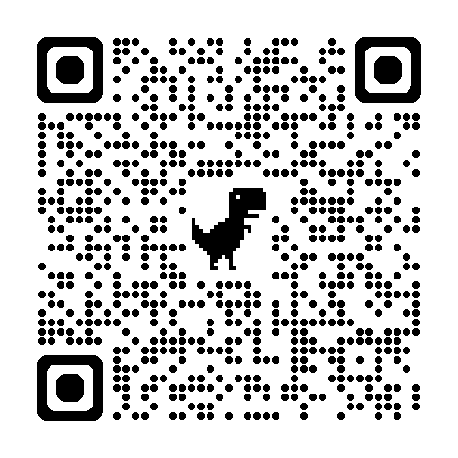
EXIT TICKET · 5 MINUTES
Help shape the next AI PD
Your answers decide which tools we support, what we train next, and whether anything is still missing.
Notes:
Give people the full five minutes. Honest answers about what didn't work are the most useful.

Slide 13

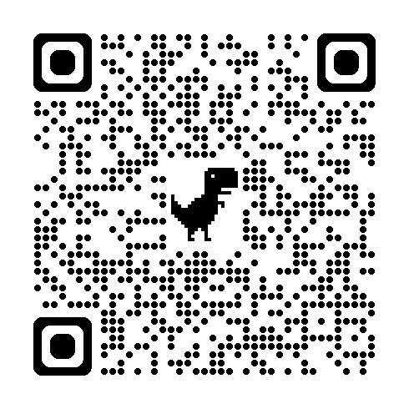
Professional Meeting Log 2026-2027
Meeting Name: Choose your own AI adventure
https://tinyurl.com/ycycht85

Slide 14
AISA · AI & INNOVATION
Thank you
for giving these tools a real try. Go use what you made this week.
Questions or ideas?
bbaki@aisa.sch.ae
Notes:
Thank everyone.

